Slide 1

UNIVERSITY INSTITUTE OF ENGINEERING
COMPUTER SCIENCE ENGINEERING
Computer Vision (CST-422)
Prepared By : Payal Thakur(E12720)
Topic: Image Classification Using Bag of Features
DISCOVER . LEARN . EMPOWER

Slide 2
Bag of Features
The Bag of Features (BoF) is a technique used in computer vision and image processing for representing and classifying visual data, such as images.
It is inspired by the Bag of Words (BoW) model in natural language processing.
The BoF approach treats images as collections of local visual features and represents them as histograms of visual words.
An image is represented as a collection of local image descriptors, also known as visual features.
These features capture important characteristics of the image, such as edges, corners, or textures.

Slide 3
Bag of Features
However, it discards spatial information and the relative arrangement of visual features within an image, which can limit its discriminative power in certain scenarios.
It is often used in combination with other techniques or as a baseline for comparison with more advanced approaches like Convolutional Neural Networks (CNNs).

Slide 4
Steps Involved in Bag of Features
1. Feature Extraction :
Extract local visual features from the images using algorithms like Scale-Invariant Feature Transform (SIFT), Speeded-Up Robust Features (SURF), or Oriented FAST and Rotated BRIEF (ORB).
These features capture distinctive information about the image content, such as corners, edges, or texture patterns.
It involves extracting local features from images and representing them in a fixed-length feature vector.

Slide 5
Steps Involved in Bag of Features
1. Feature Extraction :
Keypoint Detection: Detect keypoints or interest points in the input images. These keypoints are locations in the image that are distinctive and repeatable, such as corners, blobs, or edges. Popular algorithms for keypoint detection include Harris corner detection, Scale-Invariant Feature Transform (SIFT), or Speeded Up Robust Features (SURF).
Feature Descriptor Extraction: Extract feature descriptors around each detected keypoint. The feature descriptors capture the visual information within a local region around the keypoints. Commonly used descriptors include SIFT, SURF, or Oriented FAST and Rotated BRIEF (ORB). These descriptors encode information about the gradient magnitude and orientation, color, texture, or other relevant visual properties.

Slide 6
Steps Involved in Bag of Features
1. Feature Extraction :
Feature Vector Quantization: Create a visual vocabulary or codebook by applying a clustering algorithm to the extracted feature descriptors. The clustering algorithm groups similar descriptors together to form visual words or codewords. K-means clustering is a popular choice for this step, where K represents the desired number of visual words or codewords.
Assign Visual Words: Assign each feature descriptor to the nearest visual word or codeword based on a distance metric such as Euclidean distance or cosine similarity. This step converts the continuous feature descriptors into discrete visual words. Each image is then represented as a histogram or bag of visual words, indicating the frequency of occurrence of each visual word in the image.

Slide 7
Steps Involved in Bag of Features
1. Feature Extraction :
Feature Vector Normalization: Normalize the bag of visual words representation of each image. Common normalization techniques include L1 or L2 normalization, which ensure that the feature vectors are invariant to the image's scale or intensity variations.

Slide 8
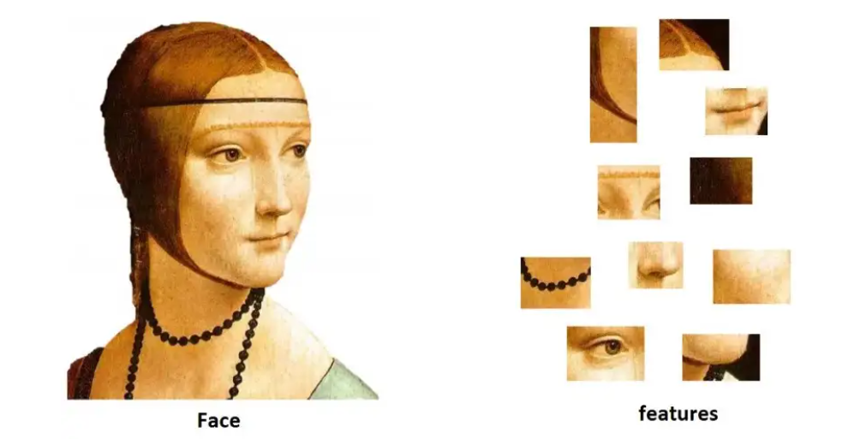

Slide 9
Steps Involved in Bag of Features
2. Feature Representation:
Feature representation refers to the process of extracting and encoding local image features in order to create a robust representation of the image.
Create a visual vocabulary by applying clustering algorithms like K-means on the extracted features.
The clustering algorithm groups similar features into clusters or "visual words."
Each cluster represents a visual word or a component of the visual vocabulary.

Slide 10
Steps Involved in Bag of Features
2. Feature Representation:
Extract Local Image Features: Local image features, such as Scale-Invariant Feature Transform (SIFT), Speeded-Up Robust Features (SURF), or Oriented FAST and Rotated BRIEF (ORB), are extracted from key points or interest regions in the image. These local features capture distinctive information about the image content.
Build a Vocabulary: Create a visual vocabulary, also known as a codebook or dictionary, by clustering the extracted local features from a set of training images. Common clustering algorithms used for this purpose include k-means or hierarchical clustering. The number of clusters or visual words determines the size of the vocabulary.

Slide 11
Steps Involved in Bag of Features
2. Feature Representation:
Assign Features to Visual Words: For each local feature extracted from an image, assign it to the closest visual word in the vocabulary. This process is known as feature quantization or vector quantization. This step maps the continuous-valued local features to discrete visual words.
Generate Histogram Representation: Count the occurrences of each visual word in the image and create a histogram representation. This histogram represents the frequency or presence of each visual word in the image. The histogram encodes the image's overall visual content in terms of the distribution of visual words.

Slide 12
Steps Involved in Bag of Features
2. Feature Representation:
Normalize the Histogram: Normalize the histogram representation to make it robust to variations in image size or intensity. Common normalization techniques include L1 or L2 normalization, which scale the histogram values to sum up to 1 or have a unit Euclidean norm.
Repeat for all Images: Repeat the above steps for all the images in the dataset, generating a bag of features representation for each image. Each image is represented by a normalized histogram of visual words.

Slide 13
Steps Involved in Bag of Features
2. Feature Representation:
Train a Classifier: Finally, the bag of features representations can be used as input to train a machine learning classifier, such as Support Vector Machines (SVM), Random Forests, or Neural Networks. The classifier learns to classify images based on their bag of features representation.

Slide 14
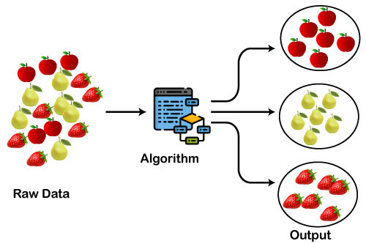

Slide 15
Steps Involved in Bag of Features
3. Feature Encoding:
For each image, assign the extracted features to their nearest visual word in the vocabulary.
Create a histogram that counts the occurrences of each visual word in the image.
This histogram represents the frequency or presence of each visual word in the image.
Feature encoding aims to summarize the distribution of visual words within an image or a region. Various encoding methods can be used, but two popular techniques are:

Slide 16
Steps Involved in Bag of Features
3. Feature Encoding:
Bag-of-Words (BoW): In BoW encoding, a histogram is created, where each visual word corresponds to a bin, and the count of assigned visual words to that bin represents the frequency of occurrence. This histogram captures the frequency information but ignores the spatial arrangement of features.
Vector Quantization (VQ): VQ encoding preserves the spatial information of features. Instead of counting the frequency of visual words, VQ encodes each feature by representing it with the closest visual word from the codebook. This results in a vector of discrete indices. The concatenation of these indices forms the encoded representation.

Slide 17
Steps Involved in Bag of Features
4. Pooling:
Pooling is the process of aggregating the assigned visual words within predefined regions of the image to create a fixed-length representation.
Optionally, apply spatial pooling techniques to aggregate local feature representations across different regions of an image.
Pooling can help capture spatial information to some extent.
There are different pooling techniques used in the bag-of-features model, including:

Slide 18
Steps Involved in Bag of Features
4. Pooling:
Max Pooling: Selects the maximum value from each visual word's occurrence within a region.
Sum Pooling: Accumulates the counts of each visual word within a region.
Average Pooling: Calculates the average occurrence of each visual word within a region.
The pooling technique chosen depends on the specific requirements of the task and the characteristics of the dataset.

Slide 19
Steps Involved in Bag of Features
5. Classification:
Use the histograms of visual words as the input data and their associated class labels to train a classifier, such as Support Vector Machines (SVM), Random Forests, or Naive Bayes.
The classifier learns the relationship between the visual word histograms and their associated classes.

Slide 20
Steps Involved in Bag of Features
6. Testing:
Given a new, unseen image, extract local visual features, assign them to the visual words in the vocabulary, create a histogram representation, and feed it into the trained classifier to predict its class label.

Slide 21
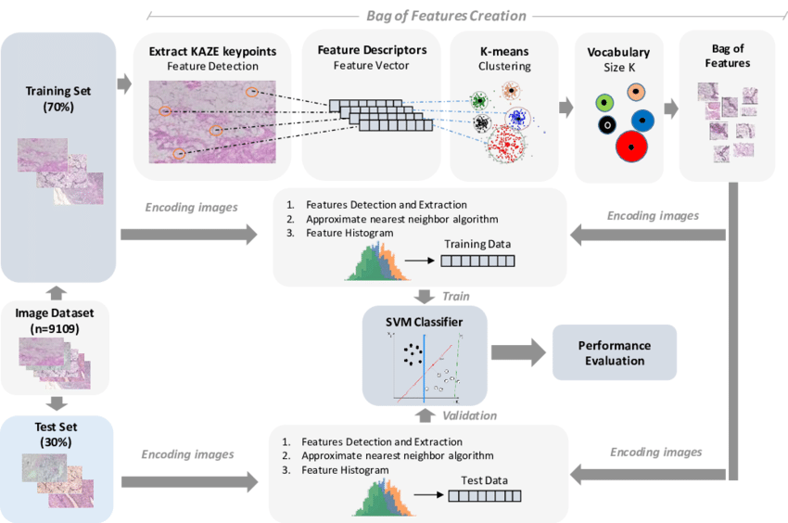

Slide 22
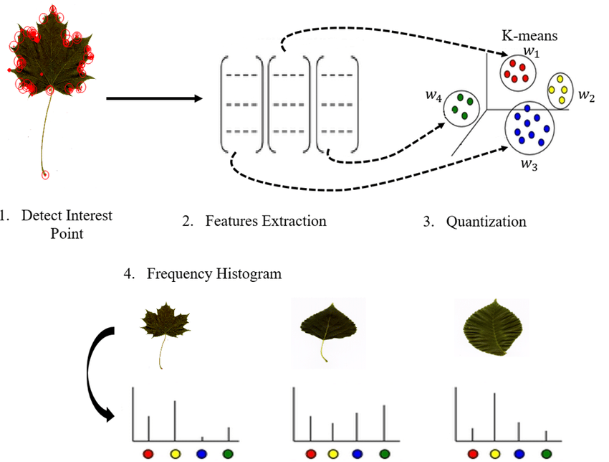

Slide 23
Introduction Are you curious about how your camera phone automatically tags your photos with keywords or how Google Photos can sort your images by the objects in them? These abilities are made possible by a technique called Bag of Features (BoF). BoF is a powerful method used in computer vision and image processing that allows images to be represented in a compact and meaningful way. In this blog, we will dive into the inner workings of BoF and explore its benefits and limitations. From understanding the basic steps of feature extraction and clustering to learning how to implement it using Python, we’ll cover everything you need to know to start using BoF in your projects. Whether you’re a computer vision beginner or an expert, join us on a journey to discover the magic of Bag of Features and understand how it can be applied in various computer vision and image processing applications. Learning Objectives Understand the basic concepts and steps involved in the Bag of Features (BoF) process, including feature extraction, feature encoding, and image classification. Learn about different feature extraction methods and compare BoF to other techniques, such as SIFT and SURF. Gain knowledge of various clustering techniques used in BoF, such as k-means and hierarchical clustering. Learn about real-world applications of BoF and the implementation of BoF using programming languages and libraries such as Python and OpenCV. Understand the limitations and challenges of BoF and recent advances in the field, such as deep learning techniques to improve feature extraction. This article was published as a part of the Data Science Blogathon. Table of Contents Understanding The Concept of Bag of Features Steps Involved in BoF Comparing BoF to Other Feature Extraction Methods Different Clustering Techniques Used in BoF Real-world Applications and Use Cases of BoF Implementing BoF using Codes Limitations and Challenges Faced by BoF Recent Advancement in the field of BOF Conclusion Understanding The Concept of Bag of Features Bag of Features (BoF) is a technique used in computer vision and image processing to extract and represent features from images in a compact and meaningful way. The basic idea behind BoF is to extract local features from an image, such as SIFT, SURF, or ORB, and then use clustering techniques to group the features into a set of visual words. Each image is then represented by a histogram of these visual words, which is called a bag of features. Bag of Features The Bag of features representation is used in many computer vision and image processing tasks such as image retrieval, object recognition, and semantic segmentation. In image retrieval, BoF is used to represent images compactly and efficiently, allowing for fast and accurate retrieval of similar images. In object recognition, BoF extracts features from images and trains a classifier to recognize objects in new images. In semantic segmentation, BoF is used to extract features from images and train a model to predict the semantic labels of the pixels in the image. Become a Full Stack Data Scientist Transform into an expert and significantly impact the world of data science. BoF has been a powerful technique in computer vision and image processing due to its ability to extract and represent features in a compact and meaningful way. Additionally, the histogram representation of BoF allows fast and efficient comparison of images. However, it is computationally expensive and requires large amounts of training data. It has been replaced by more recent techniques like deep learning-based methods, which are more efficient and accurate. Steps Involved in The BoF Process The basic steps involved in the Bag of Features (BoF) method include feature extraction, clustering, and histogram representation. Feature extraction: The first step in the BoF method is to extract local features from the images. This is done using feature detection and description methods such as SIFT, SURF, or ORB. These methods extract a set of key points and associated descriptor vectors from the image. Bag of Features Source:www.educative.io Clustering: The next step is to group the extracted features into a set of visual words. This is done by applying clustering techniques such as k-means or hierarchical clustering to the descriptor vectors. The result is a set of clusters, where each cluster represents a visual word. Bag of Features Source: javatpoint.com Histogram representation: Finally, the image is represented by a histogram of the visual words. This is done by counting the number of features that belong to each visual word and creating a histogram of these counts. The resulting histogram is the bag of features representation of the image. Source: www.toppr.com Once the feature extraction, clustering, and histogram representation steps are completed, we can use the bag of feature representation of the images to perform various tasks such as image retrieval, object recognition, and semantic segmentation. It is important to note that the number of clusters, or visual words, used in the BoF method will affect the representation of the images. Using a larger number of clusters will result in a more detailed representation, but it will also increase the computational cost and memory usage. On the other hand, using a smaller number of clusters will result in a coarser representation, but it will be more efficient. Comparing BoF to Other Feature Extraction Methods Bag of Features (BoF) is a technique used to extract and represent features from images. Still, other feature extraction methods such as SIFT (Scale-Invariant Feature Transform), SURF (Speeded-Up Robust Feature), and ORB (Oriented FAST and Rotated BRIEF) can also be used. SIFT: It is one of the most popular feature extraction methods. David Lowe introduced it in 1999. SIFT extracts key points and descriptor vectors from an image and is invariant to scale rotation and affine distortion. SIFT is robust to changes in viewpoint and illumination, but it is computationally expensive and can be sensitive to noise. SURF: SURF is a feature extraction method based on the SIFT algorithm. Herbert Bay, Tinne Tuytelaars, and Luc Van Gool introduced it in 2006. It is faster than SIFT but less robust to changes in viewpoint and illumination. ORB: ORB is a feature extraction method based on the FAST corner detector and the BRIEF descriptor. Ethan Rublee, Vincent Rabaud, Kurt Konolige, and Gary R. Bradski introduced it in 2011. ORB is faster than SIFT and SURF, and it is also less sensitive to noise. However, it is less robust to changes in viewpoint and illumination. BoF: It is a technique that uses these feature extraction methods, like SIFT, SURF, and ORB, to extract features from the image and cluster them into visual words. BoF is a powerful technique for extracting and representing features in a compact and meaningful way. But it is computationally expensive and requires large amounts of training data. In summary, each feature extraction method has its advantages and disadvantages. SIFT is robust to changes in viewpoint and illumination, but it is computationally expensive. SURF is faster than SIFT but less robust to changes in viewpoint and illumination. ORB is faster than SIFT and SURF, less sensitive to noise, but less robust to changes in viewpoint and illumination. BoF is powerful but computationally expensive and requires large amounts of training data. The choice of feature extraction method will depend on the specific requirements of the application and the trade-off between robustness and computational cost. Different Clustering Techniques Used in BoF In the Bag of Features (BoF) method, clustering techniques are used to group the extracted features into a set of visual words. Two of the most commonly used clustering techniques in BoF are k-means and hierarchical clustering. k-means K-Means: K-means is a popular clustering algorithm that partitions a set of data points into k clusters, where k is a user-specified parameter. The algorithm iteratively assigns each data point to the cluster with the nearest mean. It is simple, easy to implement, and computationally efficient. However, the number of clusters (k) must be specified in advance, and the final clustering depends on the initial cluster centers, which can result in different solutions for different initializations. Hierarchical Clustering: Hierarchical Clustering is a method of clustering that builds a hierarchy of clusters. It can be divided into two types: agglomerative and divisive. Agglomerative clustering starts with each data point as a separate cluster and merges the closest clusters. Divisive clustering starts with all data points in one cluster and splits it into smaller clusters. It is more flexible than k-means as it doesn’t require a fixed number of clusters, but it can be computationally expensive and sensitive to noise. In summary, k-means and hierarchical clustering are two popular clustering techniques that can be used in the BoF method. K-means is simple and computationally efficient, but it requires a fixed number of clusters and is sensitive to initialization. Hierarchical clustering is more flexible but can be computationally expensive and sensitive to noise. The choice of clustering technique will depend on the specific requirements of the application and the trade-off between flexibility and computational cost. Real-world Applications and Use Cases of BoF
Bag of Features (BoF) is a powerful technique for extracting and representing features from images, and it has been used in a wide range of real-world applications.Some examples include:
Image retrieval: BoF has been used in image retrieval systems to represent images compactly and efficiently, allowing for fast and accurate retrieval of similar images. It has been used in applications such as image search engines, where users can search for images based on keywords or visual similarity.

Slide 24
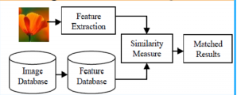

Slide 25
Introduction Are you curious about how your camera phone automatically tags your photos with keywords or how Google Photos can sort your images by the objects in them? These abilities are made possible by a technique called Bag of Features (BoF). BoF is a powerful method used in computer vision and image processing that allows images to be represented in a compact and meaningful way. In this blog, we will dive into the inner workings of BoF and explore its benefits and limitations. From understanding the basic steps of feature extraction and clustering to learning how to implement it using Python, we’ll cover everything you need to know to start using BoF in your projects. Whether you’re a computer vision beginner or an expert, join us on a journey to discover the magic of Bag of Features and understand how it can be applied in various computer vision and image processing applications. Learning Objectives Understand the basic concepts and steps involved in the Bag of Features (BoF) process, including feature extraction, feature encoding, and image classification. Learn about different feature extraction methods and compare BoF to other techniques, such as SIFT and SURF. Gain knowledge of various clustering techniques used in BoF, such as k-means and hierarchical clustering. Learn about real-world applications of BoF and the implementation of BoF using programming languages and libraries such as Python and OpenCV. Understand the limitations and challenges of BoF and recent advances in the field, such as deep learning techniques to improve feature extraction. This article was published as a part of the Data Science Blogathon. Table of Contents Understanding The Concept of Bag of Features Steps Involved in BoF Comparing BoF to Other Feature Extraction Methods Different Clustering Techniques Used in BoF Real-world Applications and Use Cases of BoF Implementing BoF using Codes Limitations and Challenges Faced by BoF Recent Advancement in the field of BOF Conclusion Understanding The Concept of Bag of Features Bag of Features (BoF) is a technique used in computer vision and image processing to extract and represent features from images in a compact and meaningful way. The basic idea behind BoF is to extract local features from an image, such as SIFT, SURF, or ORB, and then use clustering techniques to group the features into a set of visual words. Each image is then represented by a histogram of these visual words, which is called a bag of features. Bag of Features The Bag of features representation is used in many computer vision and image processing tasks such as image retrieval, object recognition, and semantic segmentation. In image retrieval, BoF is used to represent images compactly and efficiently, allowing for fast and accurate retrieval of similar images. In object recognition, BoF extracts features from images and trains a classifier to recognize objects in new images. In semantic segmentation, BoF is used to extract features from images and train a model to predict the semantic labels of the pixels in the image. Become a Full Stack Data Scientist Transform into an expert and significantly impact the world of data science. BoF has been a powerful technique in computer vision and image processing due to its ability to extract and represent features in a compact and meaningful way. Additionally, the histogram representation of BoF allows fast and efficient comparison of images. However, it is computationally expensive and requires large amounts of training data. It has been replaced by more recent techniques like deep learning-based methods, which are more efficient and accurate. Steps Involved in The BoF Process The basic steps involved in the Bag of Features (BoF) method include feature extraction, clustering, and histogram representation. Feature extraction: The first step in the BoF method is to extract local features from the images. This is done using feature detection and description methods such as SIFT, SURF, or ORB. These methods extract a set of key points and associated descriptor vectors from the image. Bag of Features Source:www.educative.io Clustering: The next step is to group the extracted features into a set of visual words. This is done by applying clustering techniques such as k-means or hierarchical clustering to the descriptor vectors. The result is a set of clusters, where each cluster represents a visual word. Bag of Features Source: javatpoint.com Histogram representation: Finally, the image is represented by a histogram of the visual words. This is done by counting the number of features that belong to each visual word and creating a histogram of these counts. The resulting histogram is the bag of features representation of the image. Source: www.toppr.com Once the feature extraction, clustering, and histogram representation steps are completed, we can use the bag of feature representation of the images to perform various tasks such as image retrieval, object recognition, and semantic segmentation. It is important to note that the number of clusters, or visual words, used in the BoF method will affect the representation of the images. Using a larger number of clusters will result in a more detailed representation, but it will also increase the computational cost and memory usage. On the other hand, using a smaller number of clusters will result in a coarser representation, but it will be more efficient. Comparing BoF to Other Feature Extraction Methods Bag of Features (BoF) is a technique used to extract and represent features from images. Still, other feature extraction methods such as SIFT (Scale-Invariant Feature Transform), SURF (Speeded-Up Robust Feature), and ORB (Oriented FAST and Rotated BRIEF) can also be used. SIFT: It is one of the most popular feature extraction methods. David Lowe introduced it in 1999. SIFT extracts key points and descriptor vectors from an image and is invariant to scale rotation and affine distortion. SIFT is robust to changes in viewpoint and illumination, but it is computationally expensive and can be sensitive to noise. SURF: SURF is a feature extraction method based on the SIFT algorithm. Herbert Bay, Tinne Tuytelaars, and Luc Van Gool introduced it in 2006. It is faster than SIFT but less robust to changes in viewpoint and illumination. ORB: ORB is a feature extraction method based on the FAST corner detector and the BRIEF descriptor. Ethan Rublee, Vincent Rabaud, Kurt Konolige, and Gary R. Bradski introduced it in 2011. ORB is faster than SIFT and SURF, and it is also less sensitive to noise. However, it is less robust to changes in viewpoint and illumination. BoF: It is a technique that uses these feature extraction methods, like SIFT, SURF, and ORB, to extract features from the image and cluster them into visual words. BoF is a powerful technique for extracting and representing features in a compact and meaningful way. But it is computationally expensive and requires large amounts of training data. In summary, each feature extraction method has its advantages and disadvantages. SIFT is robust to changes in viewpoint and illumination, but it is computationally expensive. SURF is faster than SIFT but less robust to changes in viewpoint and illumination. ORB is faster than SIFT and SURF, less sensitive to noise, but less robust to changes in viewpoint and illumination. BoF is powerful but computationally expensive and requires large amounts of training data. The choice of feature extraction method will depend on the specific requirements of the application and the trade-off between robustness and computational cost. Different Clustering Techniques Used in BoF In the Bag of Features (BoF) method, clustering techniques are used to group the extracted features into a set of visual words. Two of the most commonly used clustering techniques in BoF are k-means and hierarchical clustering. k-means K-Means: K-means is a popular clustering algorithm that partitions a set of data points into k clusters, where k is a user-specified parameter. The algorithm iteratively assigns each data point to the cluster with the nearest mean. It is simple, easy to implement, and computationally efficient. However, the number of clusters (k) must be specified in advance, and the final clustering depends on the initial cluster centers, which can result in different solutions for different initializations. Hierarchical Clustering: Hierarchical Clustering is a method of clustering that builds a hierarchy of clusters. It can be divided into two types: agglomerative and divisive. Agglomerative clustering starts with each data point as a separate cluster and merges the closest clusters. Divisive clustering starts with all data points in one cluster and splits it into smaller clusters. It is more flexible than k-means as it doesn’t require a fixed number of clusters, but it can be computationally expensive and sensitive to noise. In summary, k-means and hierarchical clustering are two popular clustering techniques that can be used in the BoF method. K-means is simple and computationally efficient, but it requires a fixed number of clusters and is sensitive to initialization. Hierarchical clustering is more flexible but can be computationally expensive and sensitive to noise. The choice of clustering technique will depend on the specific requirements of the application and the trade-off between flexibility and computational cost. Real-world Applications and Use Cases of BoF
Object recognition: BoF has been used to extract features from images and train a classifier to recognize objects in new images. It has been used in applications such as surveillance systems, where it can be used to recognize and track objects in video streams automatically.

Slide 26
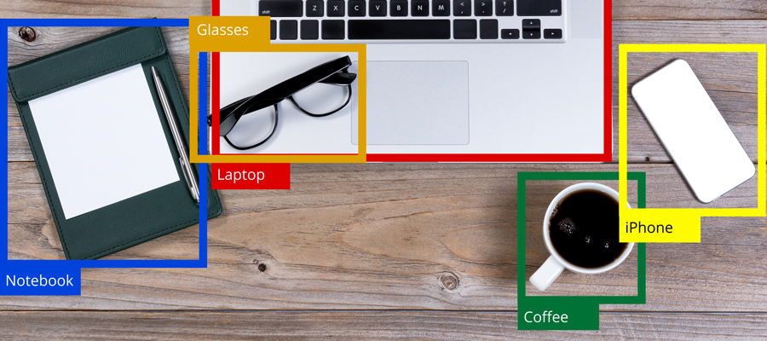

Slide 27
Introduction Are you curious about how your camera phone automatically tags your photos with keywords or how Google Photos can sort your images by the objects in them? These abilities are made possible by a technique called Bag of Features (BoF). BoF is a powerful method used in computer vision and image processing that allows images to be represented in a compact and meaningful way. In this blog, we will dive into the inner workings of BoF and explore its benefits and limitations. From understanding the basic steps of feature extraction and clustering to learning how to implement it using Python, we’ll cover everything you need to know to start using BoF in your projects. Whether you’re a computer vision beginner or an expert, join us on a journey to discover the magic of Bag of Features and understand how it can be applied in various computer vision and image processing applications. Learning Objectives Understand the basic concepts and steps involved in the Bag of Features (BoF) process, including feature extraction, feature encoding, and image classification. Learn about different feature extraction methods and compare BoF to other techniques, such as SIFT and SURF. Gain knowledge of various clustering techniques used in BoF, such as k-means and hierarchical clustering. Learn about real-world applications of BoF and the implementation of BoF using programming languages and libraries such as Python and OpenCV. Understand the limitations and challenges of BoF and recent advances in the field, such as deep learning techniques to improve feature extraction. This article was published as a part of the Data Science Blogathon. Table of Contents Understanding The Concept of Bag of Features Steps Involved in BoF Comparing BoF to Other Feature Extraction Methods Different Clustering Techniques Used in BoF Real-world Applications and Use Cases of BoF Implementing BoF using Codes Limitations and Challenges Faced by BoF Recent Advancement in the field of BOF Conclusion Understanding The Concept of Bag of Features Bag of Features (BoF) is a technique used in computer vision and image processing to extract and represent features from images in a compact and meaningful way. The basic idea behind BoF is to extract local features from an image, such as SIFT, SURF, or ORB, and then use clustering techniques to group the features into a set of visual words. Each image is then represented by a histogram of these visual words, which is called a bag of features. Bag of Features The Bag of features representation is used in many computer vision and image processing tasks such as image retrieval, object recognition, and semantic segmentation. In image retrieval, BoF is used to represent images compactly and efficiently, allowing for fast and accurate retrieval of similar images. In object recognition, BoF extracts features from images and trains a classifier to recognize objects in new images. In semantic segmentation, BoF is used to extract features from images and train a model to predict the semantic labels of the pixels in the image. Become a Full Stack Data Scientist Transform into an expert and significantly impact the world of data science. BoF has been a powerful technique in computer vision and image processing due to its ability to extract and represent features in a compact and meaningful way. Additionally, the histogram representation of BoF allows fast and efficient comparison of images. However, it is computationally expensive and requires large amounts of training data. It has been replaced by more recent techniques like deep learning-based methods, which are more efficient and accurate. Steps Involved in The BoF Process The basic steps involved in the Bag of Features (BoF) method include feature extraction, clustering, and histogram representation. Feature extraction: The first step in the BoF method is to extract local features from the images. This is done using feature detection and description methods such as SIFT, SURF, or ORB. These methods extract a set of key points and associated descriptor vectors from the image. Bag of Features Source:www.educative.io Clustering: The next step is to group the extracted features into a set of visual words. This is done by applying clustering techniques such as k-means or hierarchical clustering to the descriptor vectors. The result is a set of clusters, where each cluster represents a visual word. Bag of Features Source: javatpoint.com Histogram representation: Finally, the image is represented by a histogram of the visual words. This is done by counting the number of features that belong to each visual word and creating a histogram of these counts. The resulting histogram is the bag of features representation of the image. Source: www.toppr.com Once the feature extraction, clustering, and histogram representation steps are completed, we can use the bag of feature representation of the images to perform various tasks such as image retrieval, object recognition, and semantic segmentation. It is important to note that the number of clusters, or visual words, used in the BoF method will affect the representation of the images. Using a larger number of clusters will result in a more detailed representation, but it will also increase the computational cost and memory usage. On the other hand, using a smaller number of clusters will result in a coarser representation, but it will be more efficient. Comparing BoF to Other Feature Extraction Methods Bag of Features (BoF) is a technique used to extract and represent features from images. Still, other feature extraction methods such as SIFT (Scale-Invariant Feature Transform), SURF (Speeded-Up Robust Feature), and ORB (Oriented FAST and Rotated BRIEF) can also be used. SIFT: It is one of the most popular feature extraction methods. David Lowe introduced it in 1999. SIFT extracts key points and descriptor vectors from an image and is invariant to scale rotation and affine distortion. SIFT is robust to changes in viewpoint and illumination, but it is computationally expensive and can be sensitive to noise. SURF: SURF is a feature extraction method based on the SIFT algorithm. Herbert Bay, Tinne Tuytelaars, and Luc Van Gool introduced it in 2006. It is faster than SIFT but less robust to changes in viewpoint and illumination. ORB: ORB is a feature extraction method based on the FAST corner detector and the BRIEF descriptor. Ethan Rublee, Vincent Rabaud, Kurt Konolige, and Gary R. Bradski introduced it in 2011. ORB is faster than SIFT and SURF, and it is also less sensitive to noise. However, it is less robust to changes in viewpoint and illumination. BoF: It is a technique that uses these feature extraction methods, like SIFT, SURF, and ORB, to extract features from the image and cluster them into visual words. BoF is a powerful technique for extracting and representing features in a compact and meaningful way. But it is computationally expensive and requires large amounts of training data. In summary, each feature extraction method has its advantages and disadvantages. SIFT is robust to changes in viewpoint and illumination, but it is computationally expensive. SURF is faster than SIFT but less robust to changes in viewpoint and illumination. ORB is faster than SIFT and SURF, less sensitive to noise, but less robust to changes in viewpoint and illumination. BoF is powerful but computationally expensive and requires large amounts of training data. The choice of feature extraction method will depend on the specific requirements of the application and the trade-off between robustness and computational cost. Different Clustering Techniques Used in BoF In the Bag of Features (BoF) method, clustering techniques are used to group the extracted features into a set of visual words. Two of the most commonly used clustering techniques in BoF are k-means and hierarchical clustering. k-means K-Means: K-means is a popular clustering algorithm that partitions a set of data points into k clusters, where k is a user-specified parameter. The algorithm iteratively assigns each data point to the cluster with the nearest mean. It is simple, easy to implement, and computationally efficient. However, the number of clusters (k) must be specified in advance, and the final clustering depends on the initial cluster centers, which can result in different solutions for different initializations. Hierarchical Clustering: Hierarchical Clustering is a method of clustering that builds a hierarchy of clusters. It can be divided into two types: agglomerative and divisive. Agglomerative clustering starts with each data point as a separate cluster and merges the closest clusters. Divisive clustering starts with all data points in one cluster and splits it into smaller clusters. It is more flexible than k-means as it doesn’t require a fixed number of clusters, but it can be computationally expensive and sensitive to noise. In summary, k-means and hierarchical clustering are two popular clustering techniques that can be used in the BoF method. K-means is simple and computationally efficient, but it requires a fixed number of clusters and is sensitive to initialization. Hierarchical clustering is more flexible but can be computationally expensive and sensitive to noise. The choice of clustering technique will depend on the specific requirements of the application and the trade-off between flexibility and computational cost. Real-world Applications and Use Cases of BoF
Semantic segmentation: BoF has been used to extract features from images and train a model to predict the semantic labels of the pixels in the image. It has been used in applications such as autonomous driving, where it can be used to segment the road, vehicles, pedestrians, and other objects in an image.

Slide 28
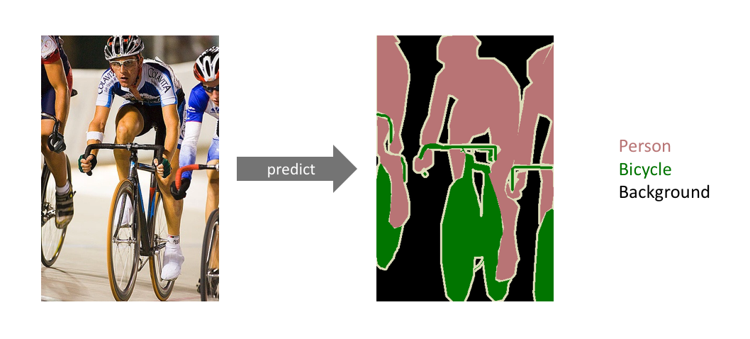

Slide 29
Introduction Are you curious about how your camera phone automatically tags your photos with keywords or how Google Photos can sort your images by the objects in them? These abilities are made possible by a technique called Bag of Features (BoF). BoF is a powerful method used in computer vision and image processing that allows images to be represented in a compact and meaningful way. In this blog, we will dive into the inner workings of BoF and explore its benefits and limitations. From understanding the basic steps of feature extraction and clustering to learning how to implement it using Python, we’ll cover everything you need to know to start using BoF in your projects. Whether you’re a computer vision beginner or an expert, join us on a journey to discover the magic of Bag of Features and understand how it can be applied in various computer vision and image processing applications. Learning Objectives Understand the basic concepts and steps involved in the Bag of Features (BoF) process, including feature extraction, feature encoding, and image classification. Learn about different feature extraction methods and compare BoF to other techniques, such as SIFT and SURF. Gain knowledge of various clustering techniques used in BoF, such as k-means and hierarchical clustering. Learn about real-world applications of BoF and the implementation of BoF using programming languages and libraries such as Python and OpenCV. Understand the limitations and challenges of BoF and recent advances in the field, such as deep learning techniques to improve feature extraction. This article was published as a part of the Data Science Blogathon. Table of Contents Understanding The Concept of Bag of Features Steps Involved in BoF Comparing BoF to Other Feature Extraction Methods Different Clustering Techniques Used in BoF Real-world Applications and Use Cases of BoF Implementing BoF using Codes Limitations and Challenges Faced by BoF Recent Advancement in the field of BOF Conclusion Understanding The Concept of Bag of Features Bag of Features (BoF) is a technique used in computer vision and image processing to extract and represent features from images in a compact and meaningful way. The basic idea behind BoF is to extract local features from an image, such as SIFT, SURF, or ORB, and then use clustering techniques to group the features into a set of visual words. Each image is then represented by a histogram of these visual words, which is called a bag of features. Bag of Features The Bag of features representation is used in many computer vision and image processing tasks such as image retrieval, object recognition, and semantic segmentation. In image retrieval, BoF is used to represent images compactly and efficiently, allowing for fast and accurate retrieval of similar images. In object recognition, BoF extracts features from images and trains a classifier to recognize objects in new images. In semantic segmentation, BoF is used to extract features from images and train a model to predict the semantic labels of the pixels in the image. Become a Full Stack Data Scientist Transform into an expert and significantly impact the world of data science. BoF has been a powerful technique in computer vision and image processing due to its ability to extract and represent features in a compact and meaningful way. Additionally, the histogram representation of BoF allows fast and efficient comparison of images. However, it is computationally expensive and requires large amounts of training data. It has been replaced by more recent techniques like deep learning-based methods, which are more efficient and accurate. Steps Involved in The BoF Process The basic steps involved in the Bag of Features (BoF) method include feature extraction, clustering, and histogram representation. Feature extraction: The first step in the BoF method is to extract local features from the images. This is done using feature detection and description methods such as SIFT, SURF, or ORB. These methods extract a set of key points and associated descriptor vectors from the image. Bag of Features Source:www.educative.io Clustering: The next step is to group the extracted features into a set of visual words. This is done by applying clustering techniques such as k-means or hierarchical clustering to the descriptor vectors. The result is a set of clusters, where each cluster represents a visual word. Bag of Features Source: javatpoint.com Histogram representation: Finally, the image is represented by a histogram of the visual words. This is done by counting the number of features that belong to each visual word and creating a histogram of these counts. The resulting histogram is the bag of features representation of the image. Source: www.toppr.com Once the feature extraction, clustering, and histogram representation steps are completed, we can use the bag of feature representation of the images to perform various tasks such as image retrieval, object recognition, and semantic segmentation. It is important to note that the number of clusters, or visual words, used in the BoF method will affect the representation of the images. Using a larger number of clusters will result in a more detailed representation, but it will also increase the computational cost and memory usage. On the other hand, using a smaller number of clusters will result in a coarser representation, but it will be more efficient. Comparing BoF to Other Feature Extraction Methods Bag of Features (BoF) is a technique used to extract and represent features from images. Still, other feature extraction methods such as SIFT (Scale-Invariant Feature Transform), SURF (Speeded-Up Robust Feature), and ORB (Oriented FAST and Rotated BRIEF) can also be used. SIFT: It is one of the most popular feature extraction methods. David Lowe introduced it in 1999. SIFT extracts key points and descriptor vectors from an image and is invariant to scale rotation and affine distortion. SIFT is robust to changes in viewpoint and illumination, but it is computationally expensive and can be sensitive to noise. SURF: SURF is a feature extraction method based on the SIFT algorithm. Herbert Bay, Tinne Tuytelaars, and Luc Van Gool introduced it in 2006. It is faster than SIFT but less robust to changes in viewpoint and illumination. ORB: ORB is a feature extraction method based on the FAST corner detector and the BRIEF descriptor. Ethan Rublee, Vincent Rabaud, Kurt Konolige, and Gary R. Bradski introduced it in 2011. ORB is faster than SIFT and SURF, and it is also less sensitive to noise. However, it is less robust to changes in viewpoint and illumination. BoF: It is a technique that uses these feature extraction methods, like SIFT, SURF, and ORB, to extract features from the image and cluster them into visual words. BoF is a powerful technique for extracting and representing features in a compact and meaningful way. But it is computationally expensive and requires large amounts of training data. In summary, each feature extraction method has its advantages and disadvantages. SIFT is robust to changes in viewpoint and illumination, but it is computationally expensive. SURF is faster than SIFT but less robust to changes in viewpoint and illumination. ORB is faster than SIFT and SURF, less sensitive to noise, but less robust to changes in viewpoint and illumination. BoF is powerful but computationally expensive and requires large amounts of training data. The choice of feature extraction method will depend on the specific requirements of the application and the trade-off between robustness and computational cost. Different Clustering Techniques Used in BoF In the Bag of Features (BoF) method, clustering techniques are used to group the extracted features into a set of visual words. Two of the most commonly used clustering techniques in BoF are k-means and hierarchical clustering. k-means K-Means: K-means is a popular clustering algorithm that partitions a set of data points into k clusters, where k is a user-specified parameter. The algorithm iteratively assigns each data point to the cluster with the nearest mean. It is simple, easy to implement, and computationally efficient. However, the number of clusters (k) must be specified in advance, and the final clustering depends on the initial cluster centers, which can result in different solutions for different initializations. Hierarchical Clustering: Hierarchical Clustering is a method of clustering that builds a hierarchy of clusters. It can be divided into two types: agglomerative and divisive. Agglomerative clustering starts with each data point as a separate cluster and merges the closest clusters. Divisive clustering starts with all data points in one cluster and splits it into smaller clusters. It is more flexible than k-means as it doesn’t require a fixed number of clusters, but it can be computationally expensive and sensitive to noise. In summary, k-means and hierarchical clustering are two popular clustering techniques that can be used in the BoF method. K-means is simple and computationally efficient, but it requires a fixed number of clusters and is sensitive to initialization. Hierarchical clustering is more flexible but can be computationally expensive and sensitive to noise. The choice of clustering technique will depend on the specific requirements of the application and the trade-off between flexibility and computational cost. Real-world Applications and Use Cases of BoF
Medical imaging: BoF has been used in medical imaging to segment and classify the structures in medical images such as CT and MRI scans. It allows for the automated detection and diagnosis of diseases, making it a valuable tool for radiologists and physicians.
Robotics: BoF has been used in robotics for object recognition and localization. It allows robots to understand their environment and identify objects, allowing them to interact with the environment more effectively.

Slide 30
References:-
Books:-
"Introduction to Computer Vision" by David Forsyth and Jean Ponce. Chapter 6: Features and Descriptors provides an in-depth explanation of feature detection, extraction, and matching algorithms.
Computer Vision: Algorithms and Applications" by Richard Szeliski. Chapter 4: Image Features covers various feature detection, extraction, and matching techniques.
Video Links
"Feature Detection and Description" by Stanford University - Computer Vision (CS231n). Available on YouTube: https://www.youtube.com/watch?v=H-HVZJ7kGI0
"Feature Matching and Homography" by University of Washington - Computer Vision (CSE 576). Available on YouTube: https://www.youtube.com/watch?v=uvSCXyYpG9k
"Introduction to Feature Detection and Matching" by OpenCV. Available on YouTube: https://www.youtube.com/watch?v=AWoG8vdw4pA

Slide 31
THANK YOU
For queries
Email: payal.e12720@cumail.in

